Slide 1
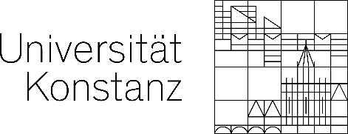
Auxetic Dihedral Escher Tessellation
Xiaokang Liu¹ Lin Lu^{1*} Lingxin Cao¹
Oliver Deussen³ Changhe Tu¹
¹ Shandong University
² University of Konstanz
Notes:
Thanks for Chair’s introduction!
My name is Liu Xiaokang from Shandong University.
It’s my pleasure to present our work “Auxetic Dihedral Escher Tessellation”
It is a joint work by Lu Lin, Cao Lingxin, and Tu Changhe from Shandong University,
And Oliver Deussen from University of Konstanz.

Slide 2
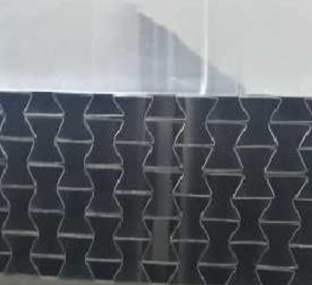
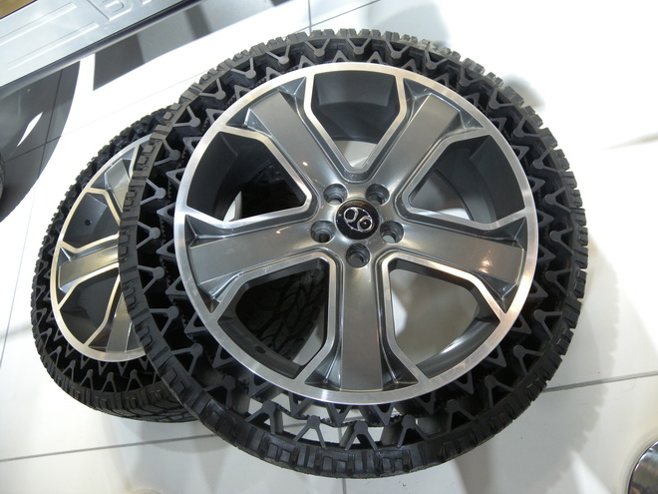
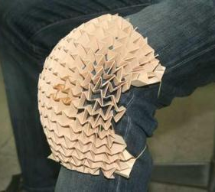
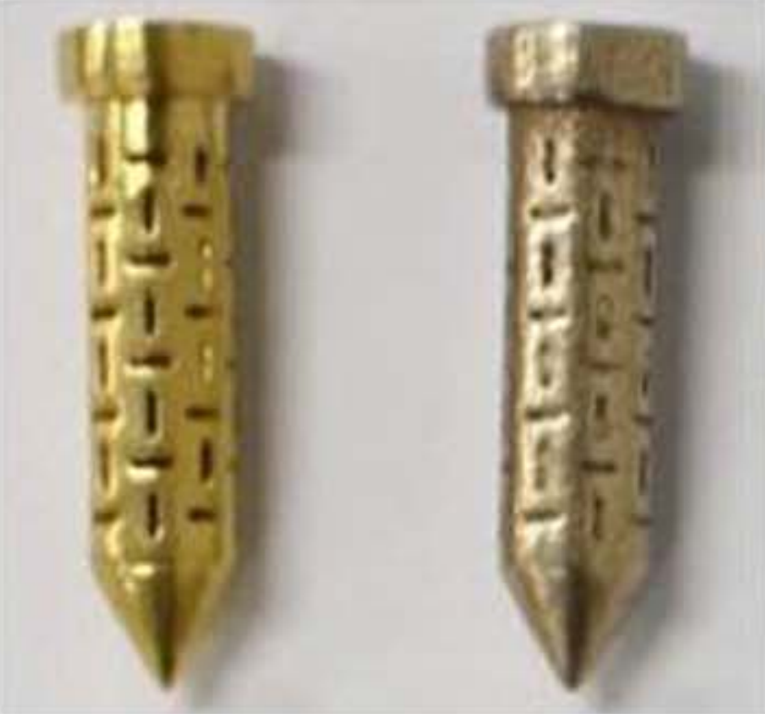
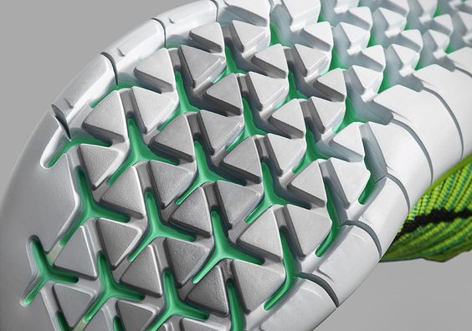
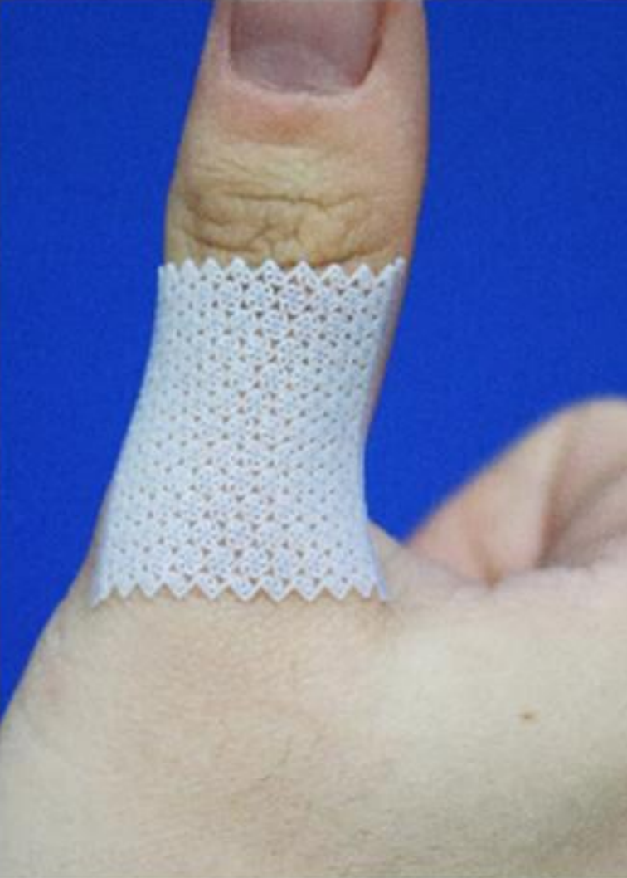
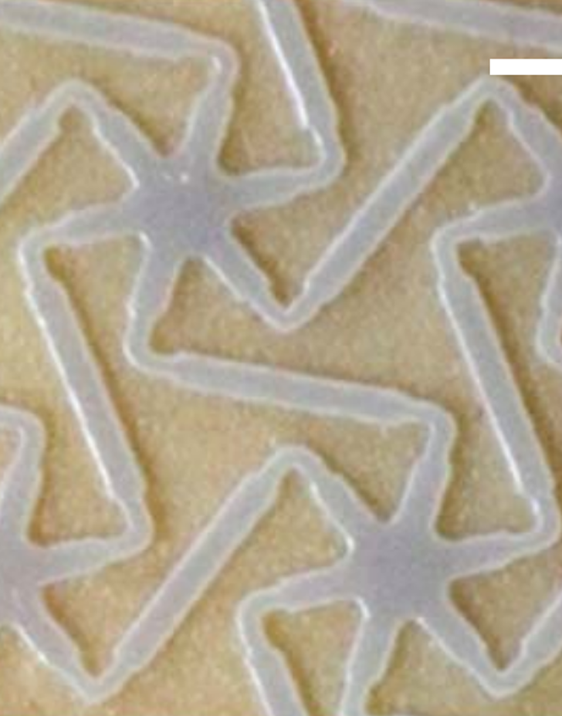
Introduction — Auxetic Structures
Auxetic materials exhibit negative Poisson's ratio properties.
Poisson’s ratio: $ν=\frac{ε_{trans}}{ε_{axial}}$
Sheet metal
Non-pneumatic tires
Kneepads
Positive Poisson's ratio
Negative Poisson's ratio
Pins
Sports soles
Medical bandages
Notes:
[Click] Auxetic materials generally exhibit negative Poisson's ratio properties.
When subjected to impact loads, traditional materials are separated on both sides while auxetic materials experience an increase in material density, enhanced compressive resistance, and higher hardness than traditional materials.
[Click] Auxetic materials have wide applications in various fields, providing functions such as impact resistance, shock absorption, and fixation

Slide 3
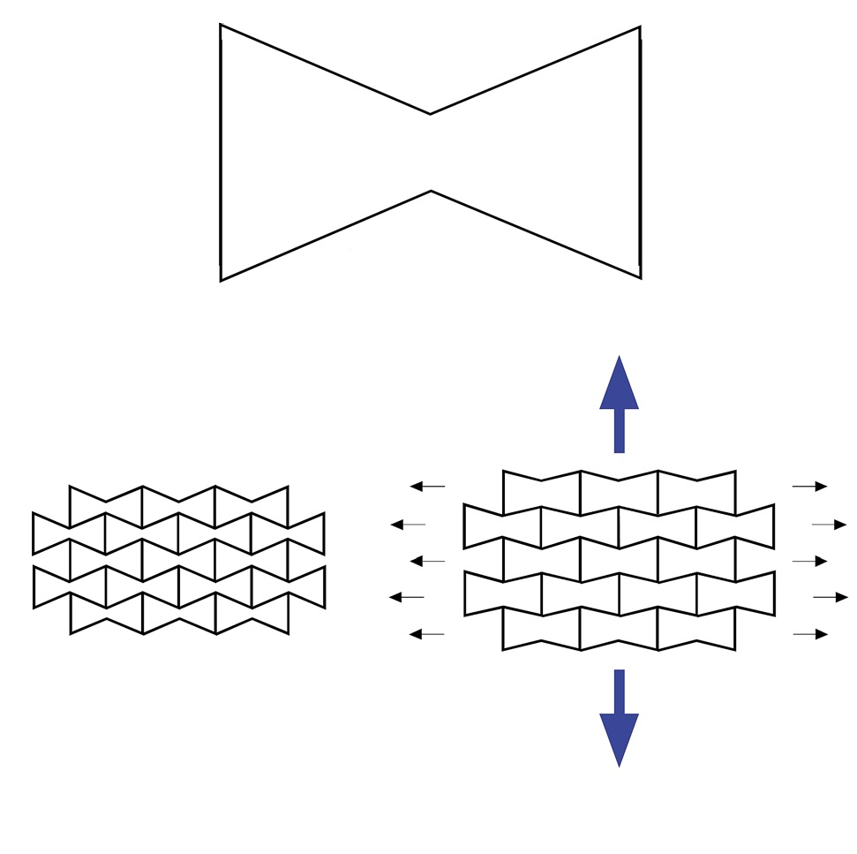
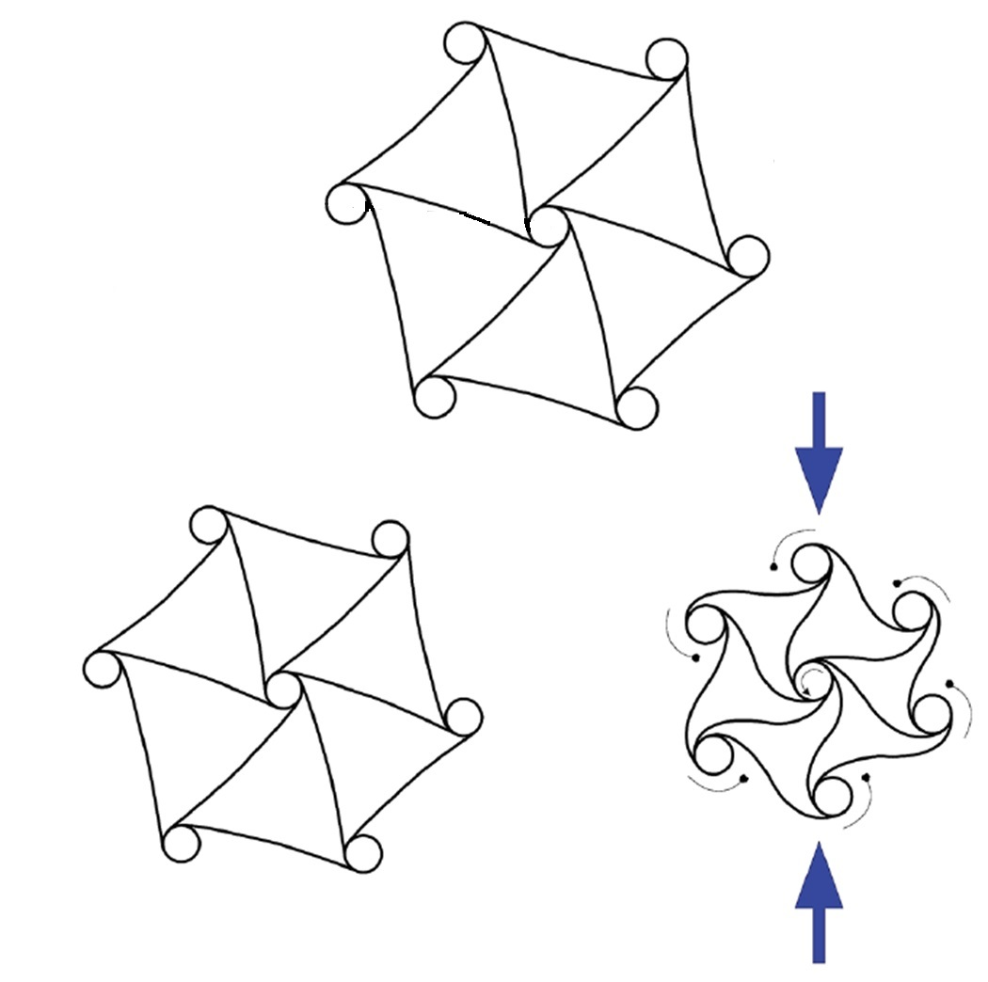
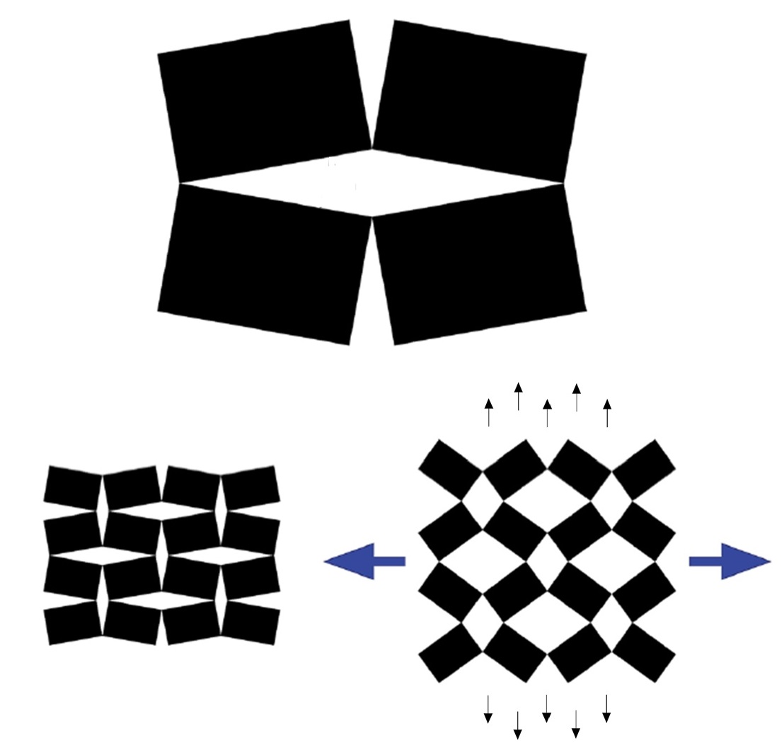
Introduction — Auxetic Structures
Common types of auxetic structures^{[1]}:
Re-entrant Structure
Chiral Structure
Rotating (semi-)rigid structure
[1] Kolken H M A, Zadpoor A A. Auxetic mechanical metamaterials[J]. RSC advances, 2017
Notes:
Common types of auxetic structures include the following three: Re-entrant Structure, Chiral Structure and Rotating (semi-)rigid structure

Slide 4
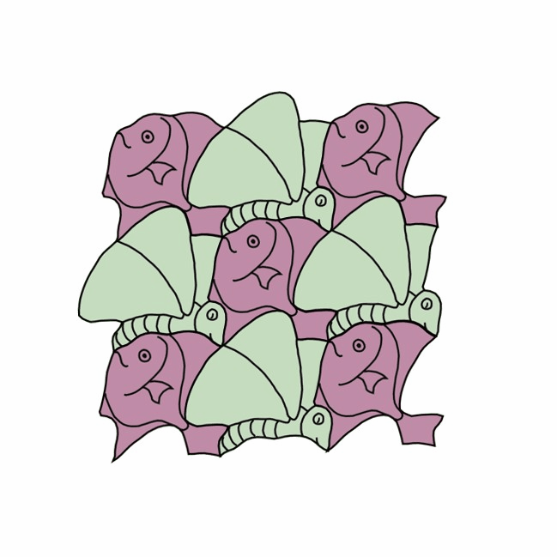
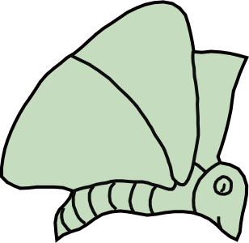
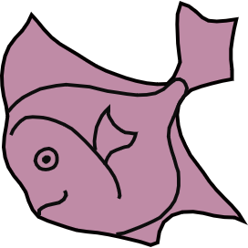
Our Goal — Auxetic Structures with Dual Shapes
C
Single Shape
Dual Shapes
Center shape C rotates counterclockwise
Notes:
In these three structures, the rotating rigid structure have clear deformation patterns and maintains unit shape unchanged.
[click] Our goal is to expand a single shape into dual shapes with meaningful contours, then the structures are
[click] cut by the red line and
[click] deployed from a closed state,
[click] presenting the dual shapes.

Slide 5
Our Goal — Auxetic Structures with Dual Shapes
C
C
Center shape C rotates counterclockwise
Notes:
However, it is challenging to directly designing meaningful shapes for units while ensuring that they can deploy without colliding.

Slide 6
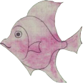
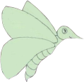
Our Goal
Given a dihedral Escher tessellation with two shapes $S_{1}$ and $S_{2}$, optimize them to obtain closed patterns $T_{1}$ and $T_{2}$, with the following requirements:
$T_{1}$ and $T_{2}$should surround each other to tessellate the entire plane;
$T_{1}$ and $T_{2}$ can be rotated and deployed without obstructing each other;
$T_{1}$ and $T_{2}$ should be as similar as possible to $S_{1}$ and $S_{2}$.
$$S_{1}$$
$$T_{1}$$
Deployability
Optimization
C
C
$$S_{2}$$
$$T_{2}$$
Input: dihedral Escher tessellation with $S_{1}$ and $S_{2}$
$T_{1}$ and $T_{2}$
Center shape C rotates counterclockwise
Notes:
Thus, we consider
[click] inputting a dihedral Escher tessellation with
[click] two shapes $S_{1}$ and $S_{2}$.
[click] And then, compute closed patterns $T_{1}$ and $T_{2}$, with the following requirements:
[click] $T_{1}$ and $T_{2}$ should surround each other to tessellate the entire plane;
[click] $T_{1}$ and $T_{2}$ can be rotated and deployed without obstructing each other;
[click] $T_{1}$ and $T_{2}$ should be as similar as possible to $S_{1}$ and $S_{2}$.

Slide 7
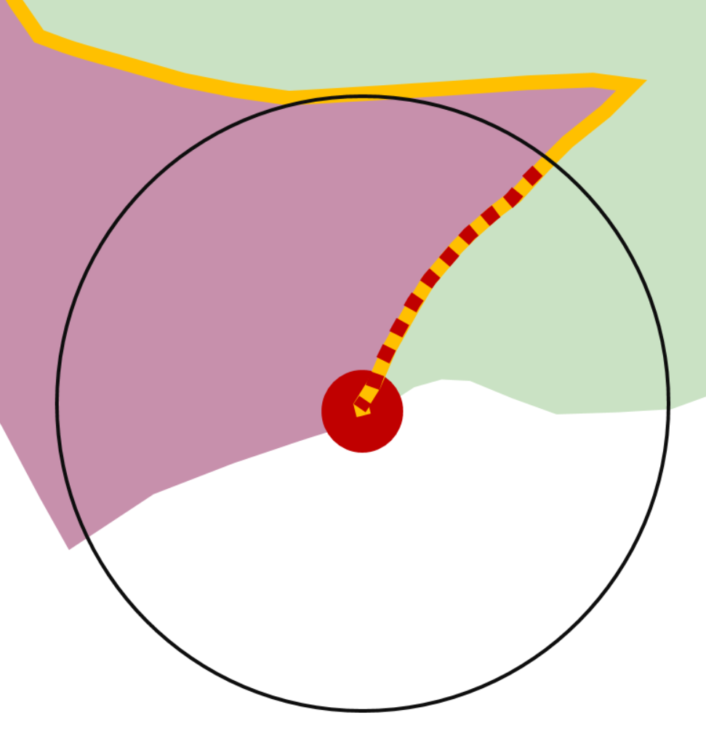
Challenges — Deployability Constraints
b
a
b
a
b
a
a
b
Frame-deployability constraints
Contour-deployability constraints
Notes:
The biggest challenge in optimization is how to maintain shape features while satisfying deployability constraints.
[click] It can be observed that the initial structure does not meet this constraint, causing separation between units [click] upon deployment.
[click] This is because the anchor frames of the units are not regular quadrilaterals, resulting in varying displacements at the connections between units, which cannot always be maintained.
[click] Additionally, sharp features on the unit contours can also cause mutual obstruction between different units, preventing smooth deployment.

Slide 8
Challenges — Deployability Constraints
Frame-deployability constraints：anchor frame of unit needs to be a regular quadrilateral;
Contour-deployability constraints：contours should not obstruct each other during rotating.
b
a
b
a
b
a
a
b
Frame-deployability constraints
Contour-deployability constraints
Notes:
Therefore, deployability constraints can be summarized as the following two points:

Slide 9
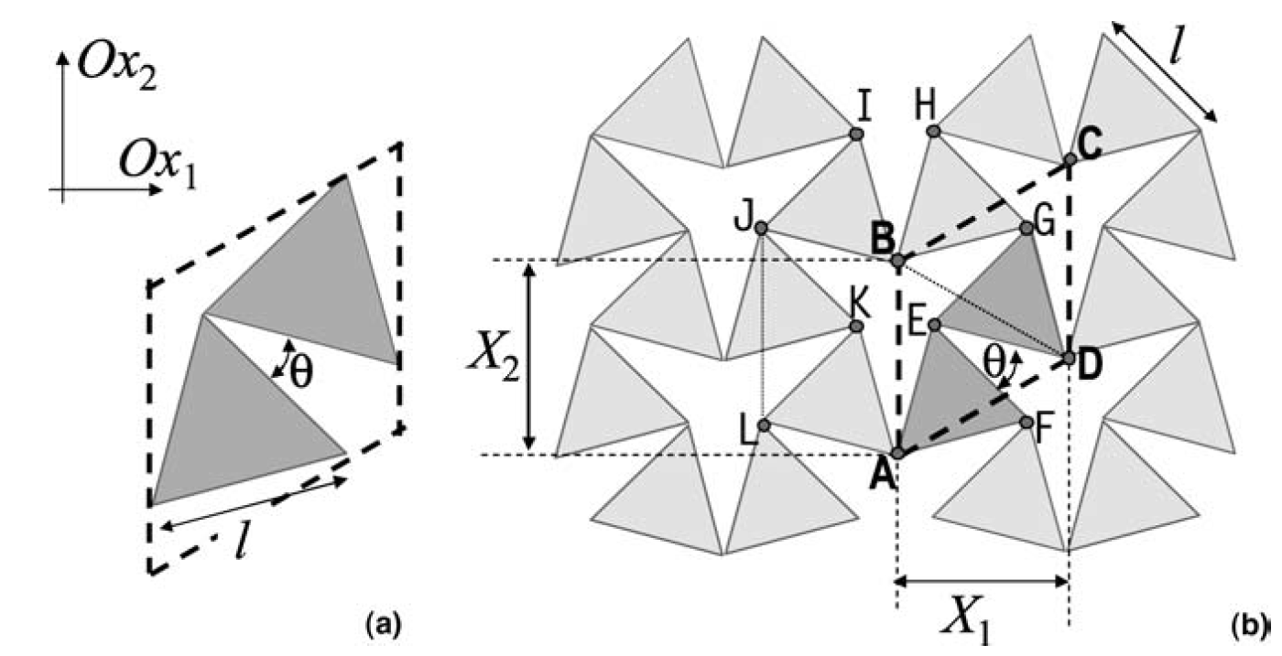
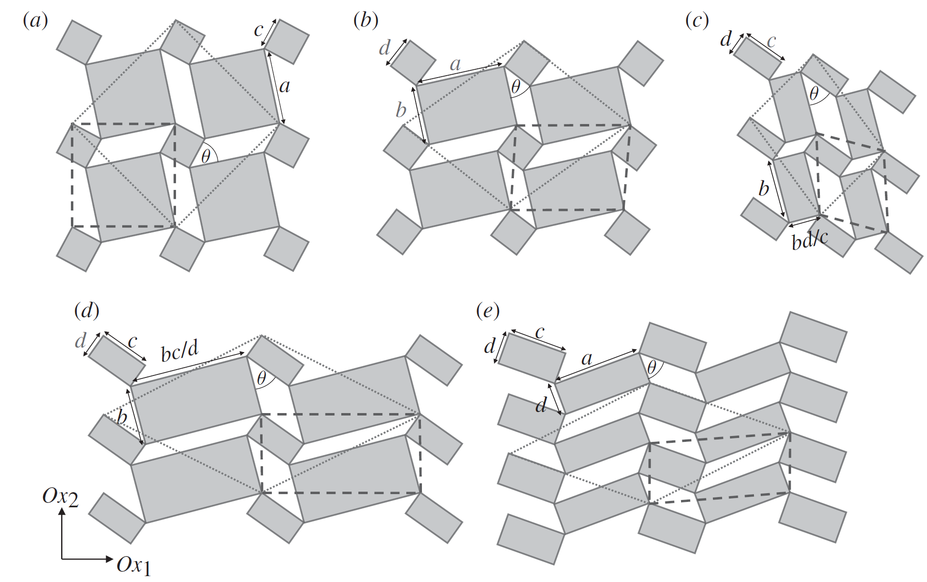
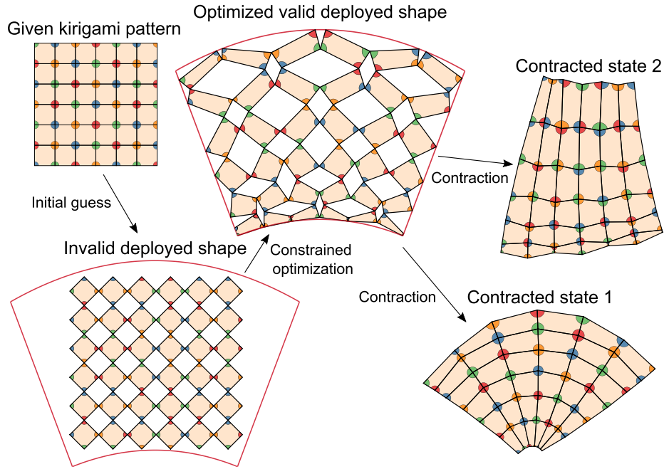
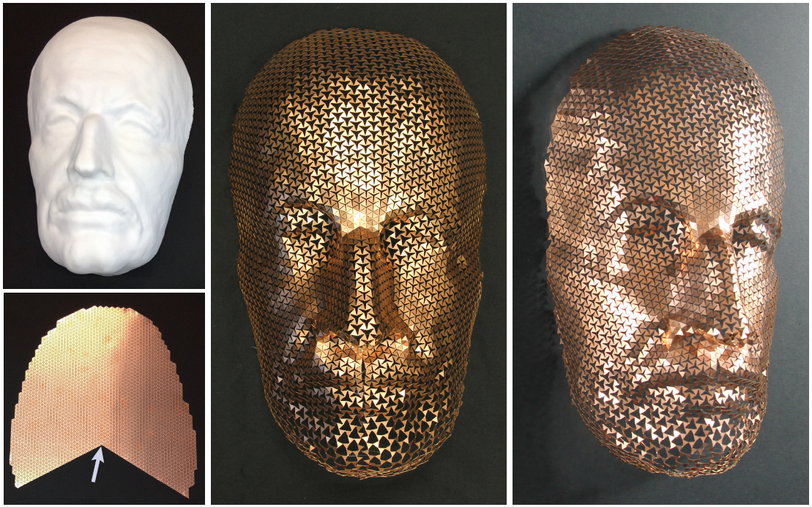
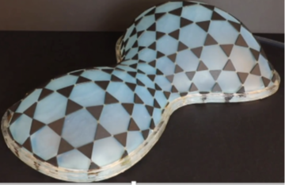
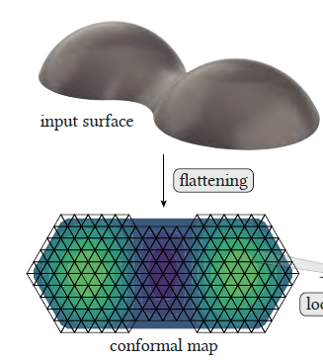
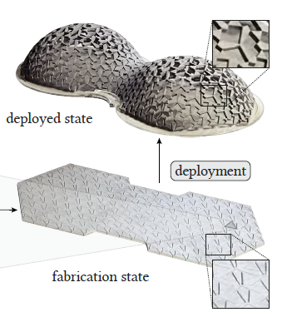
Related work — Auxetic Structures by Rotating Structures
Squares
Type I rectangles
Type II rectangles
[Grima et al. 2006, 2008, 2011]
[Choi et al. Physical Review Research, 2021]
The structure unit is simple and regular.
[Konaković et al. TOG, 2016]
[Konaković et al. TOG, 2018]
[Chen et al. TOG, 2021]
Notes:
In recent years, Grima explored the influence of parameters such as unit type, edge length, and angles on the Poisson ratio properties of these rotating rigid structures, and summarized several fixed deployment patterns.
[click] Choi et al. designed an algorithm to inversely calculate the expected compact initial state from a given target contour.
[click] Konakovic and Chen et al. discussed how to deploy such auxetic structures onto 3D surfaces.
[click] The structure units in these works adhere to simple rules, without complex or interesting shape design.

Slide 10
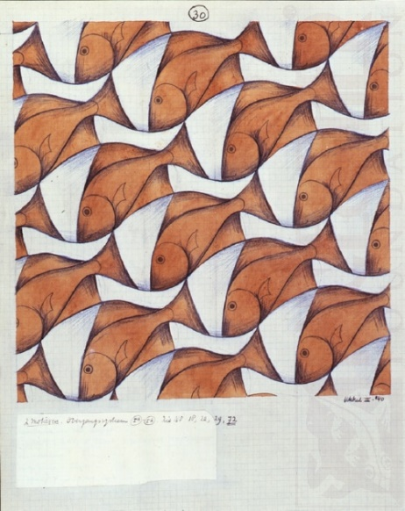
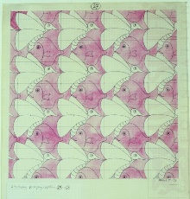
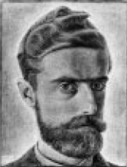
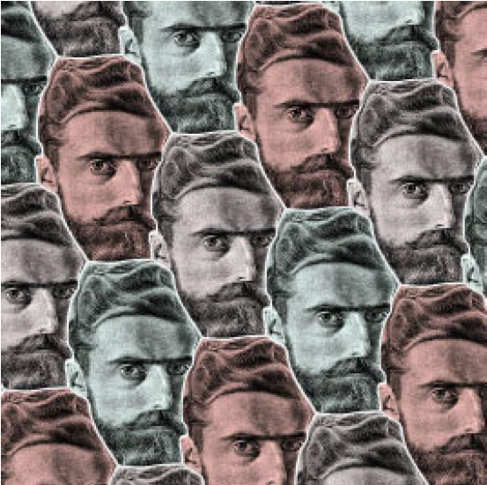
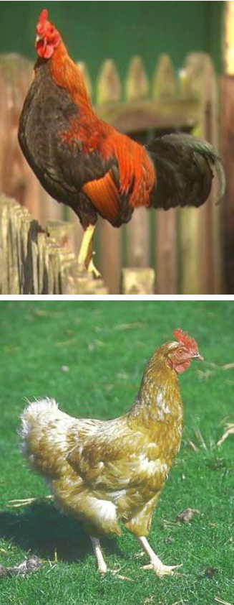
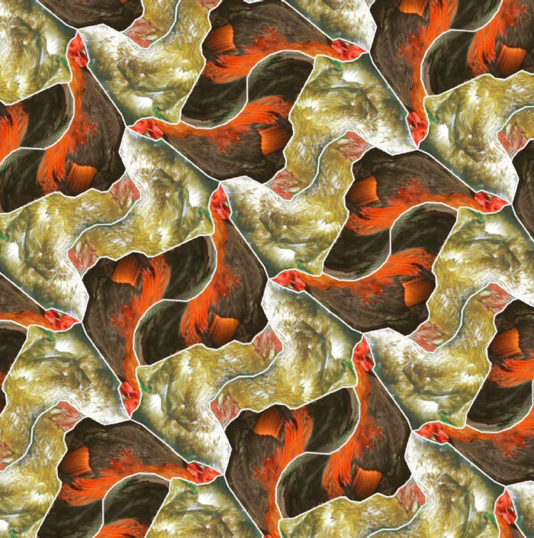
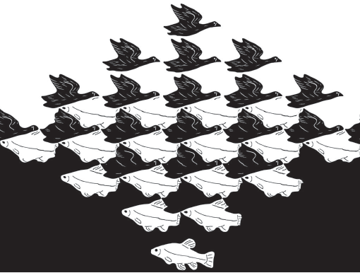
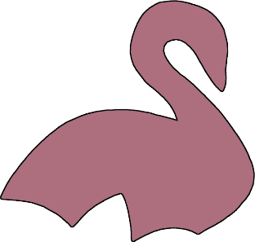
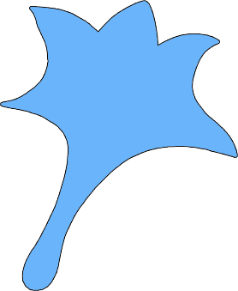
Related work — Dihedral Escher Tessellation
Artistic work of M.C. Escher
[Kaplan et al. SIGGRAPH, 2000]
[Kaplan et al. GI, 2004]
Mainly consider preserving the similarity of shapes, rather than constraints on shapes when deployed.
[Koizumi et al. NICOGRAPH, 2009]
[Lin et al. TVCG, 2018]
[Liu et al. CAD, 2020]
Notes:
Escher is a Dutch artist who has created a lot of artistic tessellation.
[click] “Escherization” was initially termed by Kaplan as a problem of tiling a plane with a given closed figure.
[click] In a follow-up, they extend their method to admit dihedral tilings using two shapes.
[click] Koizumi et al. and Lin et al. proposed new methods to generate Escher-like tiles transformations for dual shape perception.
[click] And Liu et al. better preserved the features and improved the similarity of the shapes, producing beautiful hollow models.
[click] These work mainly consider preserving the similarity of shapes, rather than constraints on shapes when deployed.

Slide 11
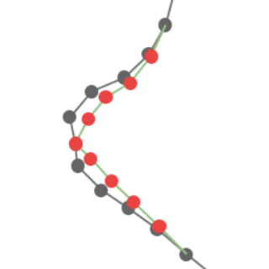
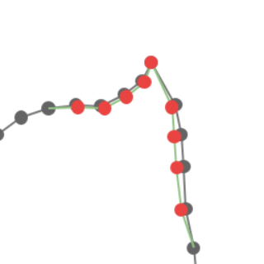
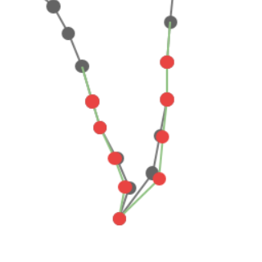
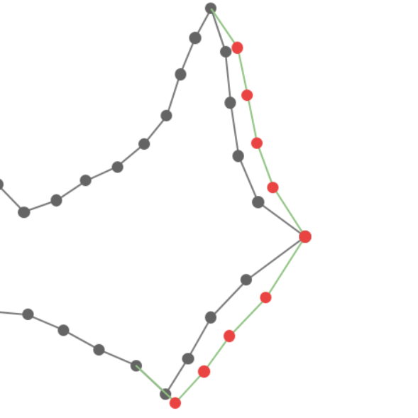
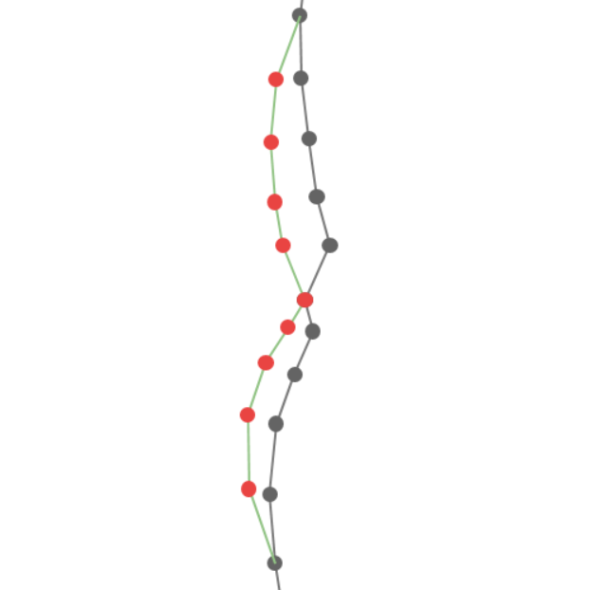
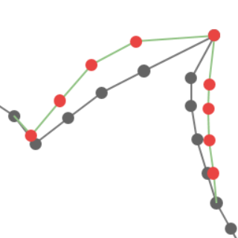
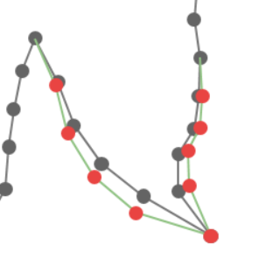
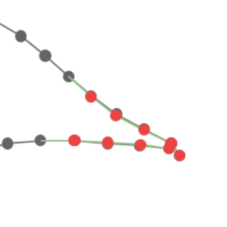
Pipeline
Notes:
Starting with the dual shapes of a dihedral tessellation,
[click] we first deform them separately using a two-step ARAP-based deformation method to transform their anchor frames into a regular geometric unit (here a rhombus).
[click] Then, we merge the two shapes and perform a contour optimization based on a deployability metric function to
[click] obtain the final auxetic dihedral Escher tessellation

Slide 12
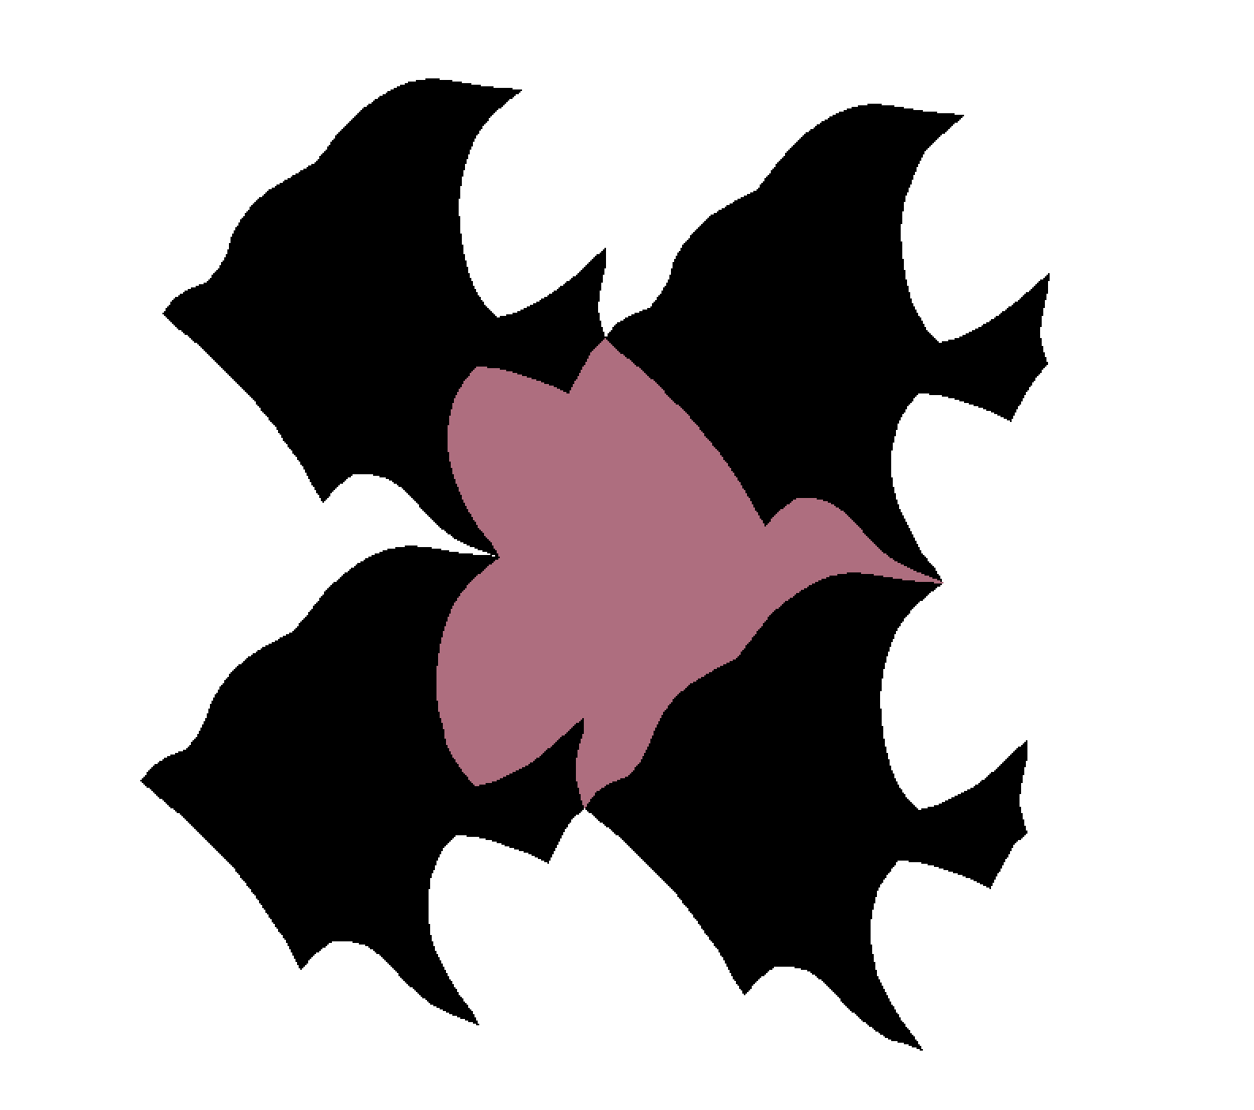
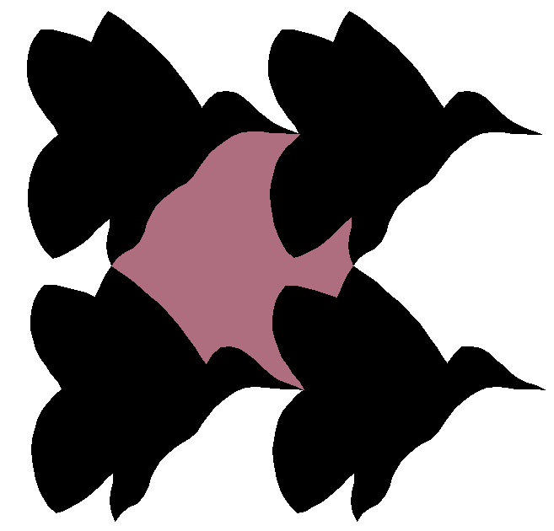
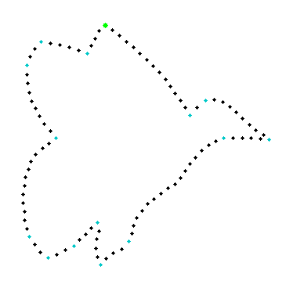
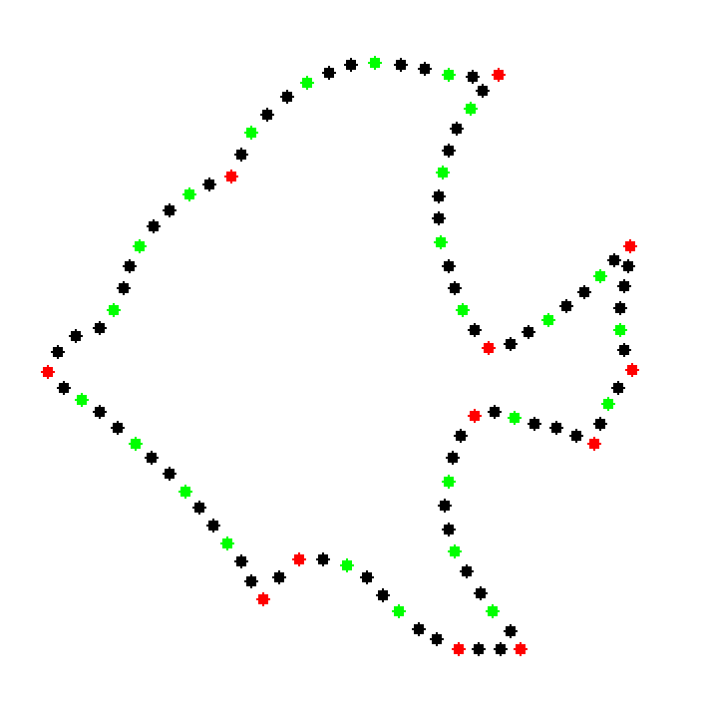
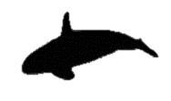
Input Dihedral Shapes
Dihedral Escher tessellation generation method^{[2]}:
0.959
0.961
S2
S2
0.957
M
0.989
S1
P2
0.952
S2
S2
0.946
0.948
Input P1
Tiling for M
Shape matching for P2
Shape morphing
[2] Liu et al. Fabricable dihedral Escher tessellations[J]. Computer-Aided Design, 2020
Notes:
For the input dihedral tessellation shape, besides Escher’s dihedral tessellation, we can also utilize Liu et al.'s generation algorithm to create new dihedral Escher tessellations based on a single shape.

Slide 13
Deployability Measurement
Frame-deployability distance，FDD
Squares
Type I rectangles
Type II rectangles
[Grima et al. Physica Status Solidi, 2008]
Notes:
Grima et al. introduced nine deploying methods for four types of regular units.
[click] For Type II structures, when they are in the closed state, one unit is always surrounded by six units.
The high degree of coupling of the boundaries makes it difficult to design complex shapes.
[click] Type β structures cannot achieve a fully tiled state when they are undeployed.
[click] Therefore, four types of geometric elements, squares, rectangles, rhombi and parallelograms, and their corresponding four deploying methods are retained as the templates.

Slide 14
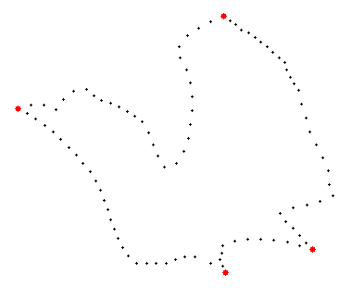
Deployability Measurement
Frame-deployability distance，FDD
Procrustes distance, PD：
$$PD\left(S^{f},S^{t}\right)=\sqrt{\sum_{i=1}^{N}{{\left|S_{i}^{f},S_{i}^{t}\right|}^{2}}}$$
$$FDD\left(S,S^{∗}\right)=\frac{PD(S^{f}, S_{min}^{t})}{Perimeter(S^{f})}$$
$S^{∗}$ is the target shape.
Initial frame
Parallelogram
Rhombus
Rectangle
Square
Notes:
Next,
[click] we calculate the shapes St​ corresponding to different types of templates for the initial frame Sf
[click] by moving anchor points.
[click] Then, we use Procrustes distance to
[click] compute the distance between the Sf​ and different St,
[click] where the smallest one becomes the target and their distance is also defined as the frame-deployability distance between S and S∗.

Slide 15
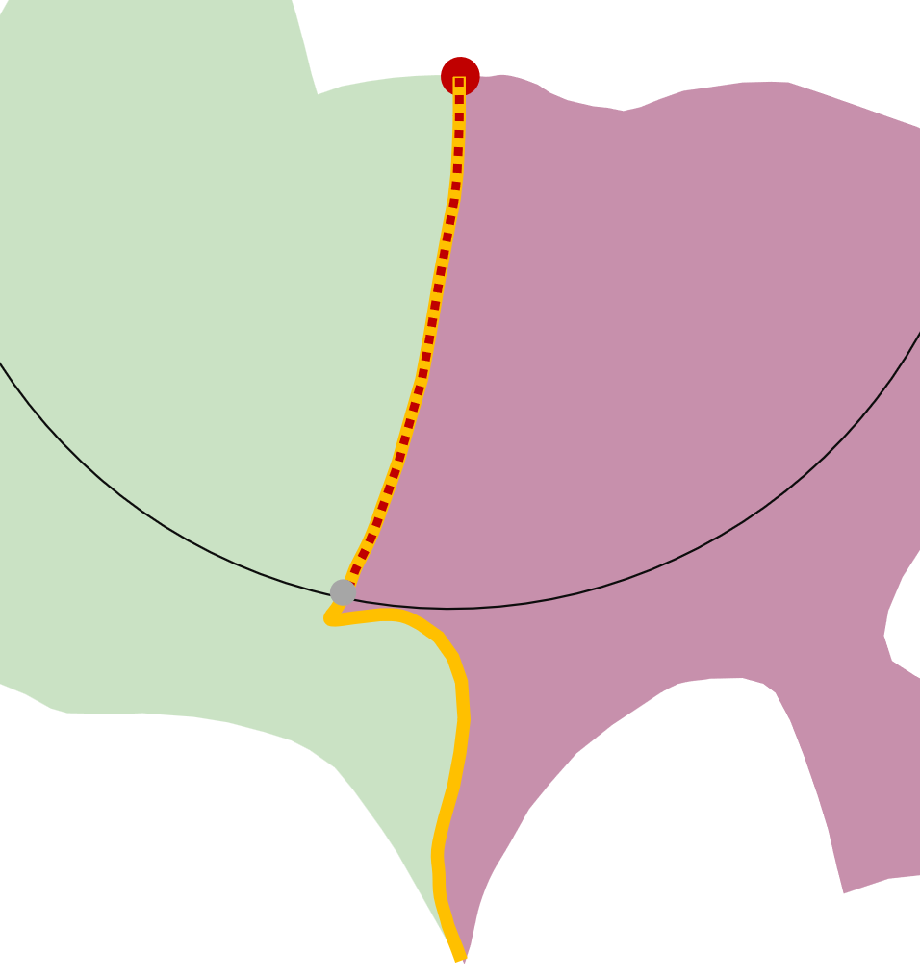
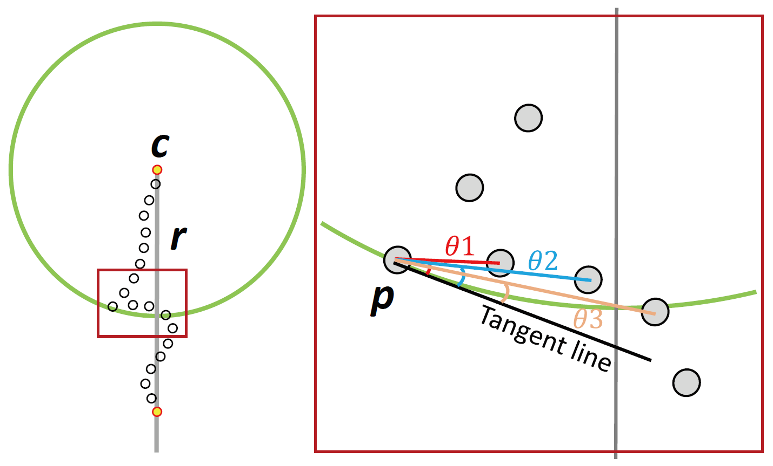
Deployability Measurement
Frame-deployability distance，FDD
Contour-deployable distance，CDD
$$CDD\left(S{,S}^{∗}\right)=\sum_{j=1}^{4}{\sum_{i=1}^{{N_{e}}_{j}}{\sum_{k=1}^{{N_{p}}_{i}}{\frac{\left|θ_{k}\right|}{πN_{p_{i}}}}}}$$
Notes:
The contour is divided by anchor points into four segments.
[click] Then, the Contour-deployable distance measures the number and angle of obstructing point pairs that occur when contour segments rotate around these anchor points on the shape.
[click] Specifically, for each point p on the segment, we check if there are obstructing points within the circular rotation path of p.
If so, we calculate the angle θ between the line connecting them and the tangent line at point p.
In this figure, there are three obstructing points, and we calculate the sum of these three angles as the deployability distance of point p.
[click] We traverse the entire edge, calculate the values for all pairs, and thus obtain the deployability distance of segment e.

Slide 16
Deployability Measurement
Frame-deployability distance，FDD
Contour-deployable distance，CDD
Overall deployability distance DepDis of shape S:
$$DepDis\left(S{,S}^{∗}\right)=FDD\left(S{,S}^{∗}\right)+CDD\left(S{,S}^{∗}\right)$$
Notes:
According to these two parts, we can obtain the Overall deployability distance of shape S

Slide 17
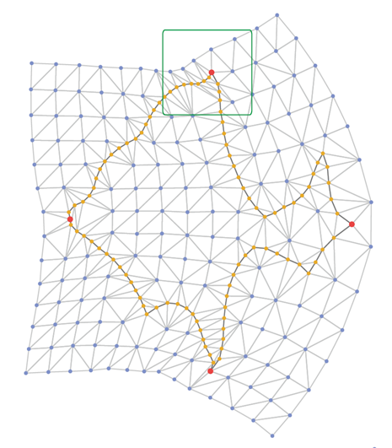
Deployability Optimization — Frame optimization
Bounding Box-based ARAP
$$DepDis\left(S{,S}^{∗}\right)=FDD\left(S{,S}^{∗}\right)+CDD\left(S{,S}^{∗}\right)$$
Initial shapes
ARAP results
Box-based ARAP
Initial shapes
ARAP results
Box-based ARAP
Notes:
Our deployability [click] optimization also consists of two steps.
[click] Firstly, we optimize the frame-deployability to deform the frame into specific regular quadrilaterals.
[click] ARAP is a deformation algorithm based on triangular meshes, as we can observe: compared to the initial shape, the sharp angles in the directly deformed result using ARAP collapse, and the abdomen of the butterfly collapses inward significantly.
[click] To address this, we introduce an ARAP algorithm based on the bounding box.
In the deformation result, the angles of the anchor points are still maintained after movement, and the collapse of the butterfly's abdomen inward is alleviated to some extent.

Slide 18
Deployability Optimization — Frame optimization
Geometric feature recovery
Notes:
Additionally, to better preserve the features near anchor points, we compute the geometric information between anchor points and their neighboring points before deformation.
After deformation, we use the preserved information to recovrey the contour features of the deformation results.

Slide 19
Deployability Optimization — Contour optimization
Shape merging
$$DepDis\left(S{,S}^{∗}\right)=FDD\left(S{,S}^{∗}\right)+CDD\left(S{,S}^{∗}\right)$$
Merge two shapes:
$$S\left(S_{2}^{′′}\right)=λ∗S\left(S_{2}^{′}\right)+\left(1−λ\right)∗S(S_{1}^{′})$$
$$S_{1}^{′}$$
$$S_{1}^{′′}$$
$$S_{1}$$
To find the $λ_{max}$ makes $S_{1}^{′′}$and $S_{2}^{′′}$ to obtain the highest similarity with $S_{1}$and $S_{2}$:
$$E_{sim}=min⁡(Sim\left(S_{1},S_{1}^{′′}\right),Sim\left(S_{2},S_{2}^{′′}\right))$$
$$S_{2}^{′}$$
Here:
$$Sim\left(A,B\right)=φ\left(A,B\right)+ω\left(A,B\right)+Insec(A,B)$$
$$S_{2}^{′′}$$
$$S_{2}$$
A shape similarity function introduced in [2]
$$ω\left(A,B\right)=Area(A∩B)/Area(A∪B)$$
Notes:
After the frame optimization is completed, [click] we proceed with contour optimization.
[click] Firstly, we need to merge the two shapes, [click] with a parameter lambda controlling the merging ratio.
[click] We introduce Esim to measure similarity and find the $λ_{max}$ makes $S_{1}^{′′}$and $S_{2}^{′′}$ to obtain the highest similarity with $S_{1}$and $S_{2}$:
[click] here the sim function comprises three parts:
[click] one from work 2 based on triangle area representation,
[click] oema measures the overall area change of the shape, and Insec quantifies potential self-intersections on the shape's contour.

Slide 20
Deployability Optimization — Contour optimization
Obstacle point pairs optimization
$$e$$
$$e$$
$$e$$
$$e$$
$${CP}_{i}^{2}$$
$${CP}_{i+1}^{2}$$
$${CP}_{i}^{1}$$
$${CP}_{i+1}^{1}$$
……
$${CP}_{i+n}^{2}$$
$${CP}_{i+n}^{1}$$
$$p_{i}^{r}$$
$$p_{i+1}^{l}$$
$$p_{i+1}^{r}$$
$$p_{i+n}^{l}$$
$$p_{i+n}^{r}$$
$$p_{i}^{l}$$
$${CP}_{i}^{0}$$
$${CP}_{i+1}^{0}$$
$${CP}_{i+n}^{0}$$
Rotate ${CP}_{i}^{0}$and its neighboring point pairs
Iterate over all obstructing point pairs on edge e
Do the same for ${CP}_{i+1}^{0}$
Iteration termination
Notes:
We detect each collided pair CPi(pil, pir ) of points pil and pir , calculate the angle θi between their connecting line and the tangent line at pil, then rotate this pair CPi and its neighbour pairs CPi+t (pil−t , pir+t ) around each pair’s medial point for a certain angle αt ∗ θi, and αt decreases as t increases. The algorithm stops when there are no more colliding points on the edge or the number of iterations reaches the upper limit

Slide 21
Deployability Optimization — Contour optimization
Non-adjacent edge optimization
Length(C₁p₁) + Length(C₃p₂) < 2a·cosθ
Opposite edges collide
Adjacent edges (without a shared edge) collide
Notes:
When deploying our structure, obstructing may arise on the other side of neighboring edges or even opposite edges.
To detect potential collisions among these edges, we check if length(C1 p1) + length(C3 p2) is always smaller than the length(C1C3), i.e., length(C1 p1) + length(C3 p2) < 2a cos θ, which guarantee that no collision will occur. it is difficult to optimize simultaneously to ensure minimal loss of shape features while completely avoiding collisions.
To address this issue, we have developed a user interface (UI) that provides an intuitive solution for optimization of these edges while also better preserving boundary features.

Slide 22
NPR Properties Analysis
Formulas for computing the Poisson's ratio of different rotating rigid structures
$$a$$
$$θ$$
$$∅$$
$$a$$
$$θ$$
$$b$$
$$Oy$$
$$Ox$$
Rectangle type I :
Rhombus type α :
Notes:
Grima had established the formulas for calculating negative Poisson’s ratio values of rotating rigid structures with anchor frames shaped as rectangles, rhombuses, and parallelograms.

Slide 23
NPR Properties Analysis
Formulas for computing the Poisson's ratio of different rotating rigid structures
$$a$$
$$b$$
$$a$$
$$θ$$
$$∅$$
$$a$$
$$θ$$
$$l_{1}$$
$$∅$$
$$b$$
$$l_{3}$$
$$θ$$
$$l_{2}$$
$$Oy$$
$$Ox$$
Parallelogram type Iα :

Slide 24
NPR Properties Analysis
Obstacle point pair optimization
Notes:
this paper mainly focuses on the structural properties during the "shrink-expand" phase.
For ease of selection, validation, and comparison, this chapter calculates the strain values of the structure at both the initial state and a certain moment during the unfolding process, and presents visual results.
此外，本文的结构受限于边界轮廓的对应问题，无法产生同样的“收缩—展开—收缩”效果，因此本文主要研究“收缩—展开”这一阶段的结构性质。为了
便于选择、检验及比较，本章在展开过程中分别计算了结构在初始状态和某一时刻展开状态的应变值，并做了如图3.13所示的可视化结果

Slide 25
Results — Auxetic dihedral Escher tessellation
Input
Dual shapes
Deployment
Input
Dual shapes
Deployment
Notes:
The first row displays the results of optimizing hand-drawn tessellations of Escher into auxetic structures.
The subsequent rows show the results of optimizing tessellations generated from a single input pattern.
It is evident that auxetic tessellations compromise the recognizability of geometric features.
Therefore, we utilized AI drawing tools such as Runway and Stable Diffusion to assist us in designing textures, aiming to enhance both the aesthetic appeal and recognizability of the deployable tessellations

Slide 26
Results — Auxetic dihedral Escher tessellation
Input
Dual shapes
Deployment
Input
Dual shapes
Deployment

Slide 27
Results — Statistics
S₁ & S₂ | S^{t}_{min} | FDD | λ | Esim | CDD | Time
Swan & Fish | Parallelogram | 0.112 | 0.45 | 0.269 | 0.161 | 18.2s
Fish & Boat | Rhombus | 0.078 | 0.5 | 0.181 | 0.608 | 18.6s
Eagle & Bird | Parallelogram | 0.070 | 0.6 | 0.114 | 0.236 | 14.3s
Duck & Flower | Parallelogram | 0.102 | 0.35 | 0.186 | 0.076 | 15.5s
Bird & Flower | Square | 0.035 | 0.55 | 0.072 | 0.217 | 14.6s
Two birds I | Parallelogram | 0.018 | 0.8 | 0.103 | 0.565 | 19.9s
Two birds II | Rhombus | 0.070 | 0.55 | 0.121 | 0.363 | 15.1s
Bird & Bat | Parallelogram | 0.069 | 0.3 | 0.146 | 0.416 | 19.6s
Notes:
Here is a statistical data display of the results mentioned above.
[click] The examples with larger CDD values often require longer optimization iteration times, but the processing time for all examples does not exceed 20 seconds.

Slide 28
Results — Fabrication
Large-scale fabrication
Notes:
This figure illustrates the design of joints for large-scale units.

Slide 29
Deployability Optimization
Small-scale fabrication
Notes:
These are some fabrication examples that can fit developable surfaces.

Slide 30
Results — Fabrication
Small-scale fabrication
Notes:
For the key to deploying at a small scale, we often retain its original connections and rely on the elasticity of the material at the rotation axis to unfold the structure. In traditional regular unit elongated structures, stress mainly concentrates at the connections. However, for complex shapes, stress can also accumulate in weak areas on the shape, so we need to appropriately reduce the width of the connections to disperse stress in weak areas.

Slide 31
Conclusion
We introduce the concept of auxetic dihedral tessellation based on rotating (semi-)rigid structure with clear unit shapes, which can be deployed into a target developable surface through actuation;
We propose an algorithm and a corresponding framework that deform given dual shapes to create a deployable dihedral Escher tessellation;
We define a deployability metric function for this rotational structure and propose a deployability optimization method based on this function.

Slide 32
Conclusion
Limitations:
Our method is limited by the input shapes. When the deployability of the input dihedral tessellation shapes is poor, this method may not be able to preserve the contour features of the shapes after deployability optimization.
The rotational degrees of freedom of quadrilateral rotating rigid structures are lower. That makes it challenging to approximate arbitrary curvatures in space as effectively as Konakovic et al.'s triangle-based auxetic structures.
Cardboard cut by laser

Slide 33
Thank you for your attention!
Everything is online: http://irc.cs.sdu.edu.cn/Dihedral/index.html

Slide 34
Results — Fabrication
Cardboard cut by laser
Rendered deployable screen
Rendered lampshade
Notes:
Here are some other fabrication results.

Slide 35
Deployability Optimization — Contour optimization
Obstacle point pairs optimization
$$e$$
$${CP}_{i}^{2}$$
$${CP}_{i+1}^{2}$$
……
$${CP}_{i}^{1}$$
$${CP}_{i+1}^{1}$$
$${CP}_{i+n}^{2}$$
$$p_{ir}$$
$$p_{il}$$
$${CP}_{i+1}^{0}$$
$${CP}_{i+n}^{1}$$
$${CP}_{i}^{0}$$
$${CP}_{i+n}^{0}$$
Rotate ${CP}_{i}^{0}$and its neighboring point pairs
Do the same for ${CP}_{i+1}^{0}$
Iterate over all obstructing point pairs on edge e
Iteration termination
Notes:
We detect each collided pair CPi(pil, pir ) of points pil and pir , calculate the angle θi between their connecting line and the tangent line at pil, then rotate this pair CPi and its neighbour pairs CPi+t (pil−t , pir+t ) around each pair’s medial point for a certain angle αt ∗ θi, and αt decreases as t increases. The algorithm stops when there are no more colliding points on the edge or the number of iterations reaches the upper limit

